Slide 1
Hybrid Deployment
Discovery
Sept 2024
Notes:
Will

Slide 2
Contents
1
The Fivetran Vision
2
Ideal Customer Profile for Hybrid
3
Discovery Questions
4
Hybrid vs. HVR
5
Positioning vs. Competition
6
Summary
Notes:
Will

Slide 3
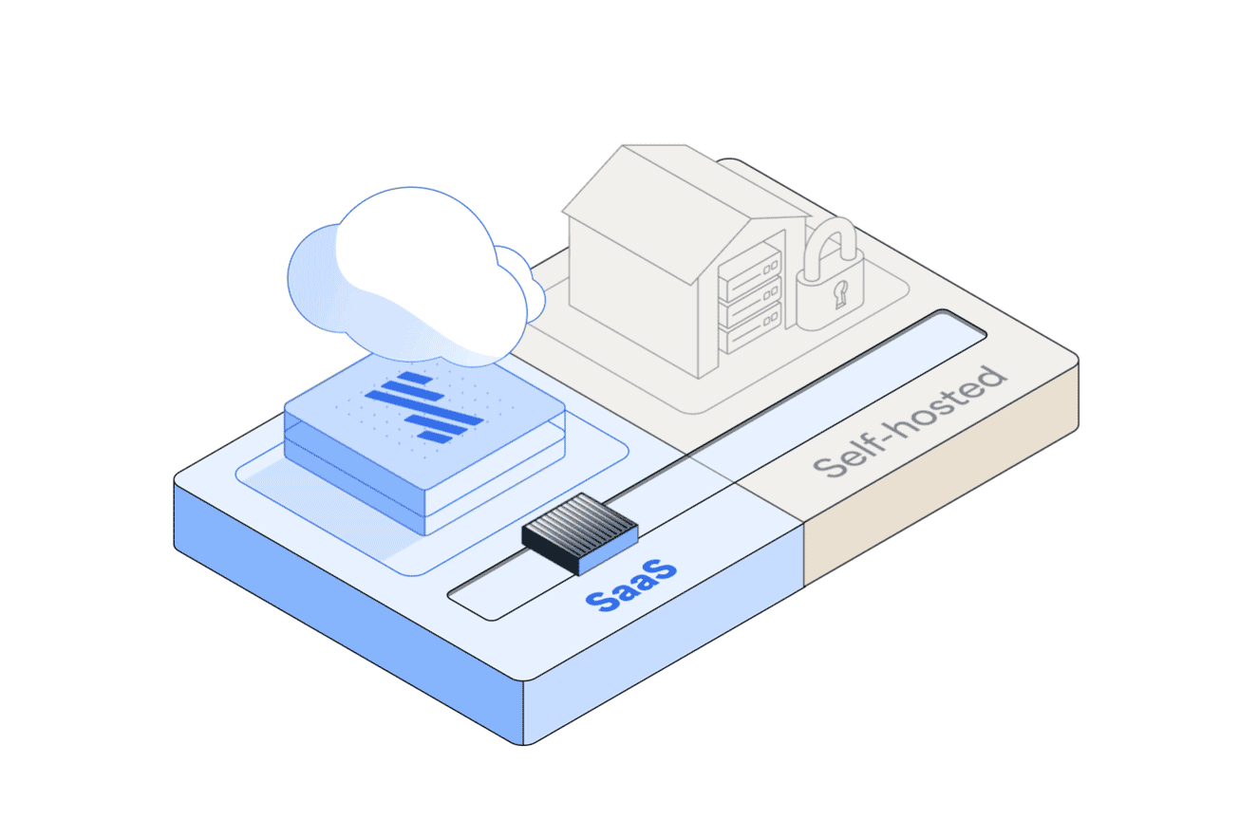
The most comprehensive data movement platform
Now with all deployment options your customer may require
SaaS
The platform is hosted in Fivetran’s secure cloud environment
Hybrid
The platform is hosted in the cloud but data is processed in your secure environment.
Self-Hosted
Self-host HVR in your local environment for high-volume replication (HVR)

Slide 4





Before: Two deployment options with tradeoffs
SaaS
The platform is hosted in Fivetran’s secure cloud environment
Customer network
Fivetran network
Destination network
Source DB
Fivetran Platform
Destination
FULLY MANAGED
APPLICATIONS
DATABASES
NO MAINTENANCE
LOCAL DATA PROCESSING
Self-Hosted
Self-host HVR in your local environment for high-volume replication (HVR)
Customer network
Destination network
Source DB
HVR
Destination
FULLY MANAGED
APPLICATIONS
DATABASES
MAINTENANCE
LOCAL DATA PROCESSING
Notes:
Hybrid is a new option for deployment.
Fivetran can be deployed as SaaS, which is the original Fivetran offering we are all familiar with. Fivetran can also be self-hosted which is the HVR technology. And finally, Fivetran supports hybrid deployments where some pipelines can be hosted in a customer’s secure environment to meet security requirements while still enabling the robust platform benefits associated with the SaaS deployment model.

Slide 5


NOW: Fivetran is a platform with three architectural options for different customer needs
SaaS
The platform is hosted in Fivetran’s secure cloud environment
Customer network
Fivetran network
Destination network
Source DB
Fivetran Platform
Destination
FULLY MANAGED
APPLICATIONS
DATABASES
NO CONFIGURATION
LOCAL DATA PROCESSING
Fivetran network
Fivetran Platform
Hybrid
The platform is hosted in the cloud but data is processed in your secure environment.
METADATA
Destination network
Customer network
On-prem or cloud
Source DB
Pipeline Processing
Destination
FULLY MANAGED
APPLICATIONS
DATABASES
NO CONFIGURATION
LOCAL DATA PROCESSING
Self-Hosted
Self-host HVR in your local environment for high-volume replication (HVR)
Customer network
Destination network
Source DB
HVR
Destination
FULLY MANAGED
APPLICATIONS
DATABASES
NO CONFIGURATION
LOCAL DATA PROCESSING
Notes:
Alex
Hybrid is a new option for deployment.
Fivetran can be deployed as SaaS, which is the original Fivetran offering we are all familiar with. Fivetran can also be self-hosted which is the HVR technology. And finally, Fivetran supports hybrid deployments where some pipelines can be hosted in a customer’s secure environment to meet security requirements while still enabling the robust platform benefits associated with the SaaS deployment model.

Slide 6
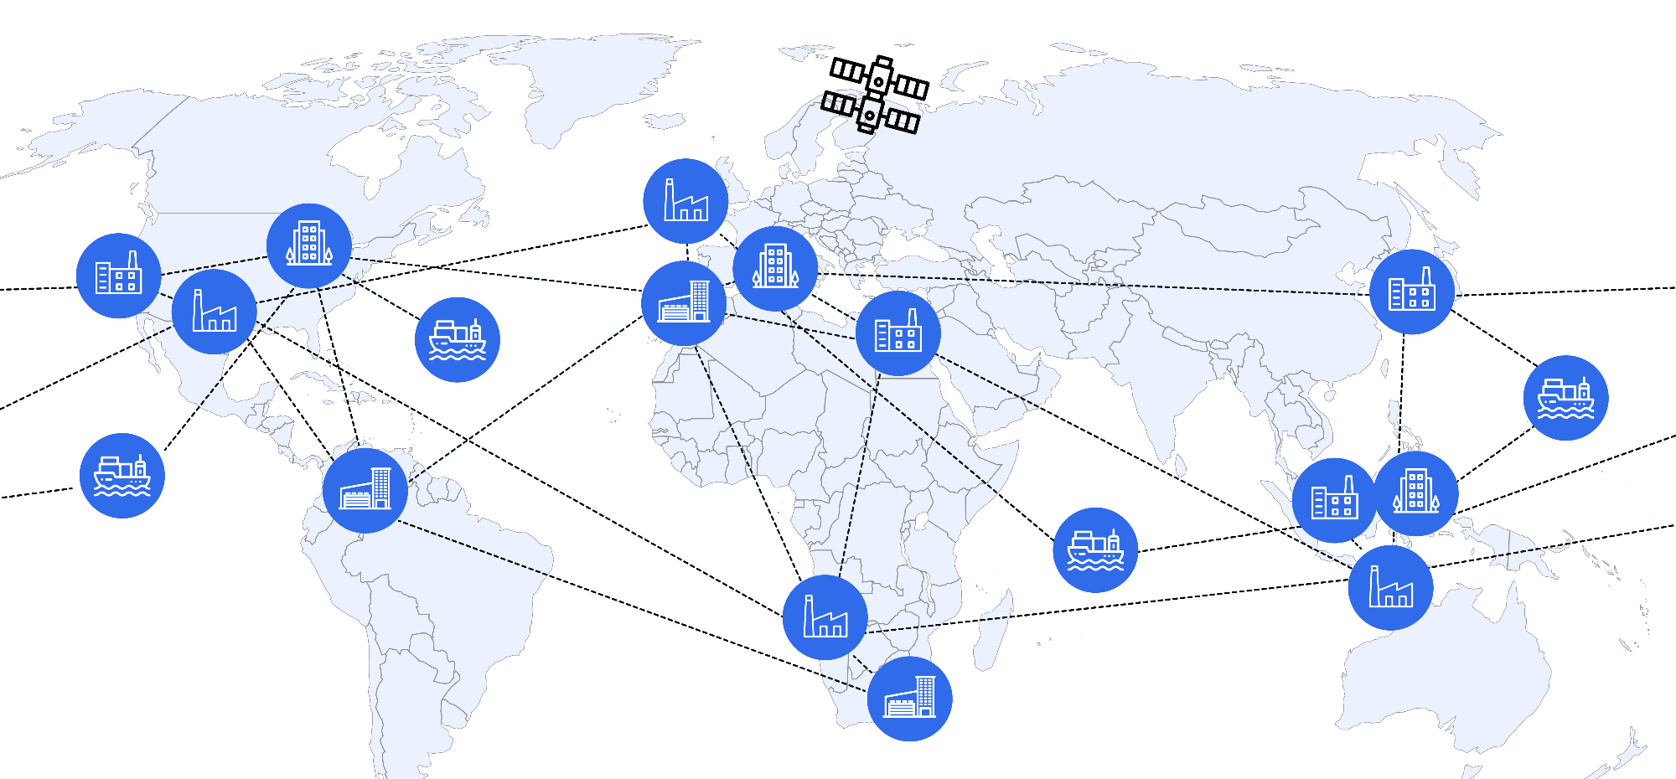

Fivetran: A single platform to securely move your data wherever or however it exists
Notes:
With Fivetran, you can “Move your data wherever and however it exists”
From cloud, on-prem, saas applications, legacy db, and even edge systems – like factories, ships, or the international space station
You can simultaneously deploy your workloads in our managed service, hybrid deployments, and on-prem, in any geography you need
Fivetran is the single platform you need to securely move all of your data wherever or however it exists for all industries - HLS, FinServ, Government, Manufacturing, Consumer Goods, and beyond

Slide 7
Ideal Customer Profile
for Hybrid Deployment

Slide 8
Ideal Customer Profile for Hybrid Deployment
Enterprise Type | Modern: companies who have adopted SaaS platforms, but aren't able to move some of their data workloads due to security restrictions Traditional: companies who have not adopted any SaaS platforms, because they have security requirements which restrict them from using 3rd party processing
Industries | Focus on regulated industries including Finance, HLS, Manufacturing, and Public Sector/Government
Use Cases | Modernization: adopt more modern, lower config, managed approaches to data movement (vs DIY or self-hosted) Centralization: centralize all of their data using a single platform, including their security restricted data sources
Locations | Global, could include some focus on EU for GDPR
Revenue ($$) | Fortune 500, Global 2000, $500M+ in revenue (USD)
Company Size | Enterprises with 2k+ employees
Current Solution | DIY pipelines or self-hosted solution (e.g. Qlik, Informatica, Talend)
Cloud Destination | Use a current supported cloud destination

Slide 9

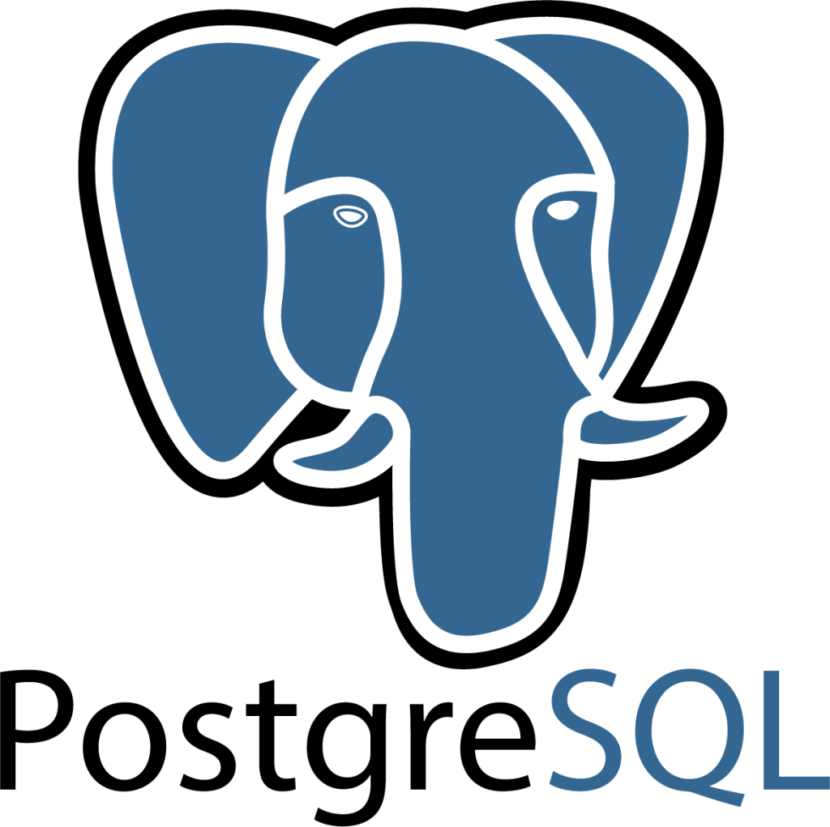




Available at Launch
Sources
Destinations
Features
SQL Server*
PostgreSQL*
Oracle*
MySQL*
MongoDB
Salesforce
SAP ERP
S3
Github
Snowflake
Databricks
PostgreSQL
BigQuery
Redshift
Catalog integrations
Metadata sharing
Alerts & notifications
Fivetran Platform Connector
Snowflake internal staging
& more…
& more
& more
*Supported for all flavors of SQL Server, Postgres, Oracle and MySQL supported on managed service. Note: Most but not all authentication methods are supported!
As of September 18, 2024
Notes:
Meera
We are rapidly expanding the sources and destinations we can support with this model. For now we can support…

Slide 10
WHO would benefit from Hybrid Deployment?
Might be a good fit
Customers who… Have a use case that is supported with existing sources/destinations Want the ease of a managed service, but need the security of locally processed data Need to replicate SaaS sources, but also on-premise databases Use both Fivetran Managed Service (SaaS) and HVR, but prefer the Managed Service model Are HVR customers with new use cases Have budget for Enterprise or Business Critical plans
Probably not a good fit (yet)
Customers who… Are doing on-prem to on-prem operational workloads Have real-time (sub 1-min latency) requirements Have extremely high throughput requirements Have a lot of configuration requirements e.g. renaming columns or tables, filtering data, custom slicing etc Tend to move slowly or are very risk averse Require the control plane to be self-hosted Are moving mission-critical workloads
Notes:
We’ve outlined the criteria for sellers to identify a potential HD opportunity which is outlined in this slide. We also want to be clear in pointing out that we are not trying to displace HVR! Sellers should continue to sell HVR when it’s the best fit

Slide 11
Discovery Questions

Slide 12

Hybrid Discovery Questions
Can you describe your current mix of data sources, including both SaaS applications and databases (on-premise and cloud)?
Which cloud data platforms and/or data lakes is your organization using today (also describe the data workloads being used for each platform)?
What specific use cases are you looking to support with your data integration solution?
Do you currently have to balance the need for managed services with your requirements for data security and local processing?
What are your primary concerns regarding data security and compliance in your current data integration processes?
How do your current data governance policies affect where your data can be stored and processed?
Can you describe any specific regulatory requirements or industry standards that impact your data management practices?
Are there any sensitive data types or specific datasets that you're particularly concerned about moving or processing outside your own infrastructure?
How important is it for your organization to maintain direct control over the data pipeline infrastructure?
What are your expectations regarding the level of support and management you'd like to have for your data integration solution?
Have you used or considered using both Fivetran's Managed Service and HVR? If so, what has been your experience?
What aspects of a managed service model are most appealing to you for your data integration needs?
Are there any new use cases or data sources you're looking to incorporate into your data integration strategy?
How would you describe your ideal balance between ease of use and control over your data processing?
How important is it for you to have a unified solution that can handle both cloud-based and on-premises data sources?
In what ways do you see your data integration needs evolving in the next 1-2 years, particularly in terms of source types and data volumes?

Slide 13
Qualifying Hybrid early in the deal?
Sources: Does the client have sources supported by Hybrid?
Destinations: Does the client have destinations supported by Hybrid?
Data Lakes: Do they need data lakes?
Features: Does the client require features not yet supported by Hybrid?
Low Latency: sub 1-min latency not supported by Hybrid
Transaction Volumes: transaction volumes >100gb / hr not supported by Hybrid
Topologies: One-to-many and bi-directional topologies not supported by Hybrid
Docker / Podman: Hybrid Deployment requires the use of Docker/Podman to function by design
Windows-Only Infrastructure: Hybrid Deployment Docker images are currently Linux based
Fully Air-Gapped Solution: Does the customer require a self-hosted control plane?
FEDRAMP: Hybrid Deployment is not FEDRAMP certified
Notes:
Will

Slide 14
Hybrid vs. HVR
Notes:
Will

Slide 15
How are Hybrid and HVR different?
 | Hybrid | HVR
Deployment | Self-hosted and SaaS pipelines | Self-hosted pipelines
Configuration | No/low configuration | Full configuration
Maintenance | Fully-managed control plane; Self-managed locally deployed pipeline | Self-managed control and data planes
Security | Data never leaves VPC (for select pipelines) | Data never leaves VPC
Control Plane | Fivetran UI | Customer network
Use case | Wants to self-host certain pipelines, while utilizing Fivetran’s fully-managed platform | Wants to self-host all pipelines, while requiring a fully air gapped solution or specific capabilities

Slide 16
Post-Discovery Considerations
(Hybrid or HVR)
Does the client have sources supported by Hybrid?
Does the client have destinations supported by Hybrid?
Will the destination require a transactional data write (less than 1 min latency)?
Does the desired approach require topologies such as One to Many Destinations, Many to One, or Bi-Directional?
Is the client requiring a self-hosted control plane?
Does the client allow Docker use?
Is streaming capture and low latency (less than 1 min) required?
Are transaction volumes (changes in an individual source) higher than 100GB/hr?
Are specific capabilities required such as schema/table/column renaming, compare/repair, custom data type support, historical/incremental separation?

Slide 17
Competitive
Notes:
David

Slide 18
Competitive High Level
Many Fivetran competitors already have competent hybrid deployment architectures.
Fivetran can differentiate on containerization and on Podman support.
Selling to Fivetran’s strengths remains critical: breadth of connectors, 99.9% uptime, strong data lake support, and data delivery as reliable as electricity.

Slide 19
Competitor characteristics
What to Say
Data Productivity Cloud has hybrid, but only supports Docker/Kubernetes
Fivetran lets you choose from multiple hybrid containerization technologies, not just one.
They have Hybrid, but without any containerization
Containerization is the way of the future for hybrid architectures. Let’s discuss all the benefits.
SaaS only - no self-hosted
Hybrid deployments allow you to run jobs where your data never leaves your secure network. These competitors have no such capability.
SaaS or self-hosted, but not Hybrid
Having on-prem option plus a SaaS option isn’t flexible enough. You need Hybrid - a shared control plane to manage all of it, and execute your pipelines in either capacity.
Hybrid is possible, but only with additional products.
Some solutions are historically self-hosted and may require multiple pieces to achieve a true hybrid architecture.
SaaS only - no hybrid agent
These products do not have a hybrid agent that can execute pipelines on another trusted network.

Slide 20




Hybrid is the future of Fivetran!
Self-host pipelines and utilize Fivetran’s fully-managed platform
Security
Speed
Support
Simplicity
Sensitive data stays in your VPC
Move large volumes of data at 5 TB/day CDC
Fully managed 24/7/365 & incident response by 500+ engineers
Single pane of glass for multiple deployments
Self-hosted & SaaS pipelines
1 min latency
99.9% uptime
Version Control
Notes:
Paul

Slide 21
Thank You
Notes:
Will

